Slide 1
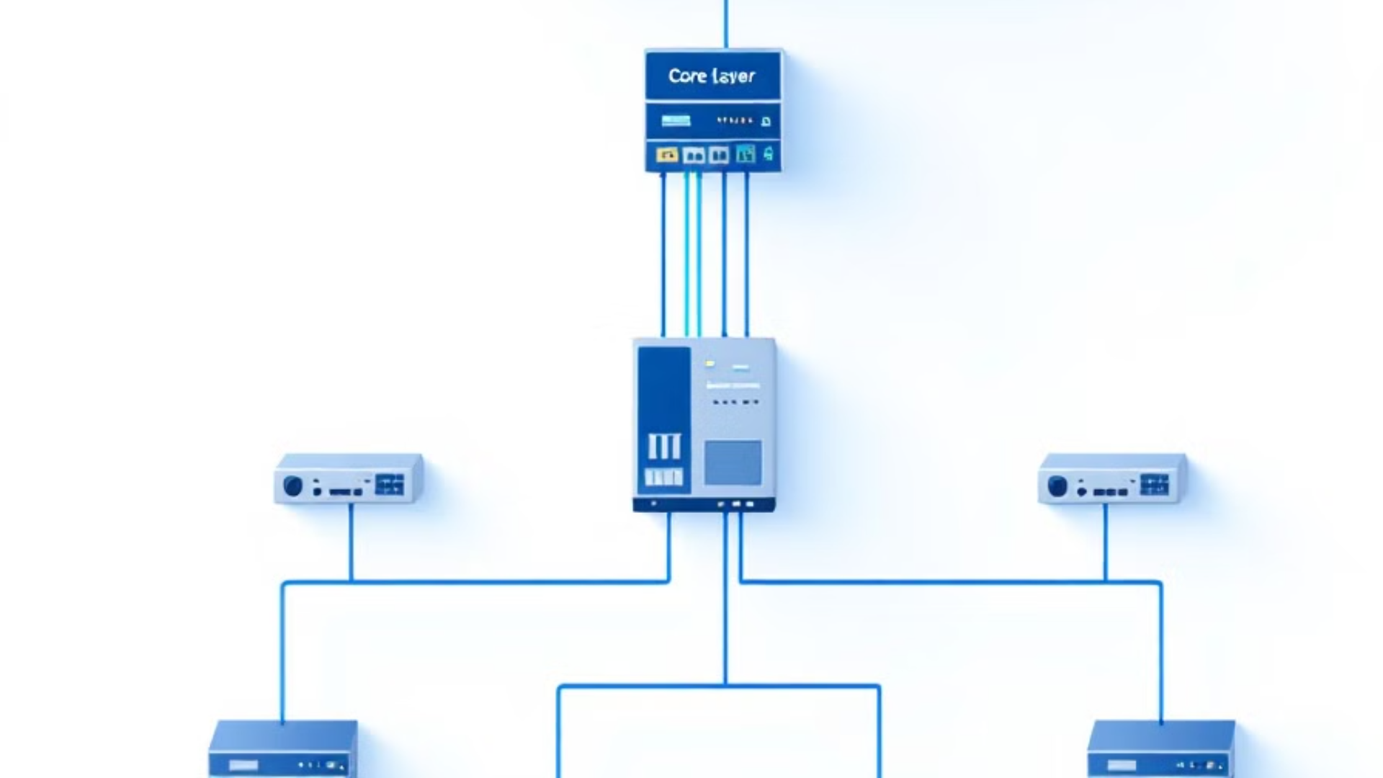
Presented by:
Nidhi
Mohamed
Alex

Slide 2

Network Infrastructure Implementation
This comprehensive presentation outlines the implementation of a secure and efficient network infrastructure. We'll explore the key components, including routers, switches, servers, and workstations, and detail the network topology, VLAN configuration, and IP addressing scheme. The project aims to create a robust network that meets the organization's needs for management, study, production, and support functions.

Slide 3





Network Equipment Overview
Router
Switches
Servers
Workstations
Cisco ISR 4331 for routing. to connect multiple networks, directing data traffic between them
One Cisco 3560 multilayer switch for inter-VLAN routing and six Cisco 2960 switches for Layer 2 connectivity.
Three servers for DNS, DHCP, and iSCSI storage functions. to provide centralized resources, services, and data
10 computers serving as user endpoints for various functions.

Slide 4
Network Hardware Costs
Device
Quantity
Unit Cost
Total Cost
Cisco ISR 4331 Router
1
€2,500
€2,500
Cisco 3560 Multilayer Switch
1
€1,500
€1500
Cisco 2960 Layer 2 Switches
6
€1,500
€9000
Servers (DNS, DHCP, iSCSI)
3
€2000
€6000
Workstations
10
€900
€9000
Total Cost:
€28,000
This table outlines the hardware costs for the network infrastructure implementation. The largest expense is the 10 workstations and the 6 layer 2 switches, followed by the servers. The Cisco router that serves as the core of the network connectivity.

Slide 5
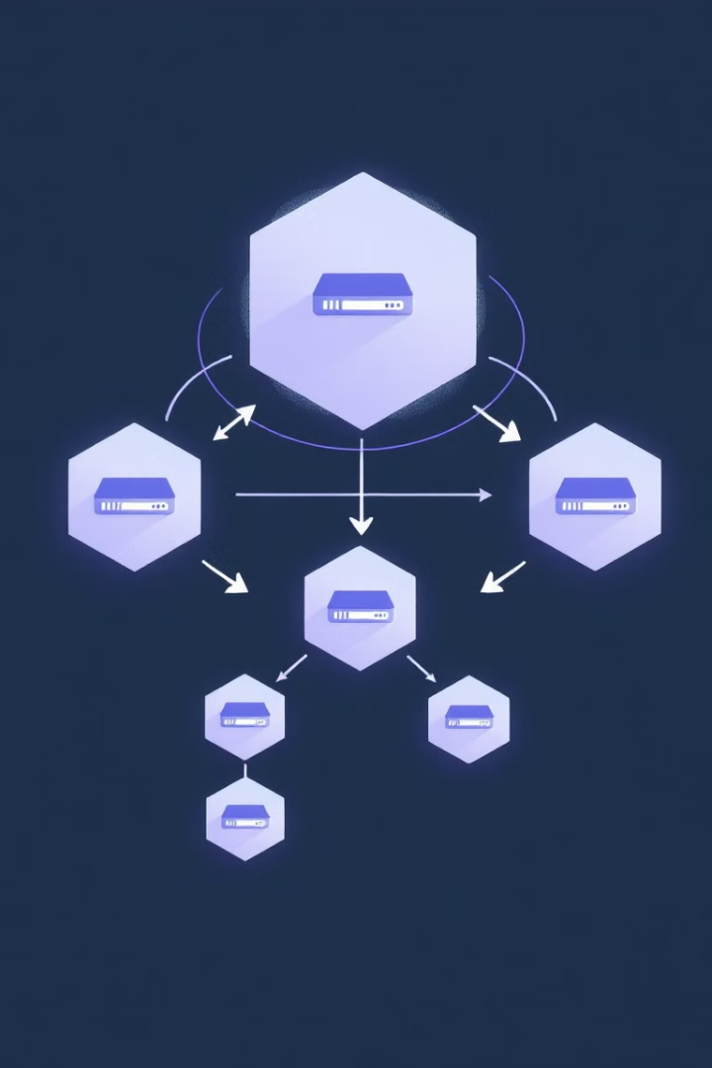
Network Topology Plan
1
Core Layer
ISR 4331 Router provides the foundation for network routing and security.
2
Distribution Layer
Multilayer Switch (Cisco 3560) handles inter-VLAN routing and connects to the core and access layers.
3
Access Layer
Six Cisco 2960 switches provide connectivity for workstations and servers across the network.

Slide 6

VLAN Segmentation
VLAN 10: Management
Dedicated network segment for administrative and management functions.
VLAN 20: Study
Isolated network for educational and research activities.
VLAN 30: Production
Secure environment for critical production systems and workflows.
VLAN 40/41: Support
Two segments designed for IT support and auxiliary services.
VLAN 1: Servers/DMZ
DHCP servers dynamically assign IP addresses to devices on a network, DNS servers translate domain names into IP addresses, and iSCSI servers enable block-level storage networking over IP networks for accessing storage devices.

Slide 7

IP Addressing Scheme
VLAN
IPs
Purpose
10
192.168.10.0/24
Management
20
192.168.20.0/24
Study
30
192.168.30.0/24
Production
40
192.168.40.0/24
Support 1
41
192.168.41.0/24
Support 2
1
192.168.1.0/24
Servers
Each VLAN is assigned its own subnet, allowing for efficient network segmentation and management. This scheme provides ample IP addresses for each department while maintaining clear boundaries between different network functions.

Slide 8
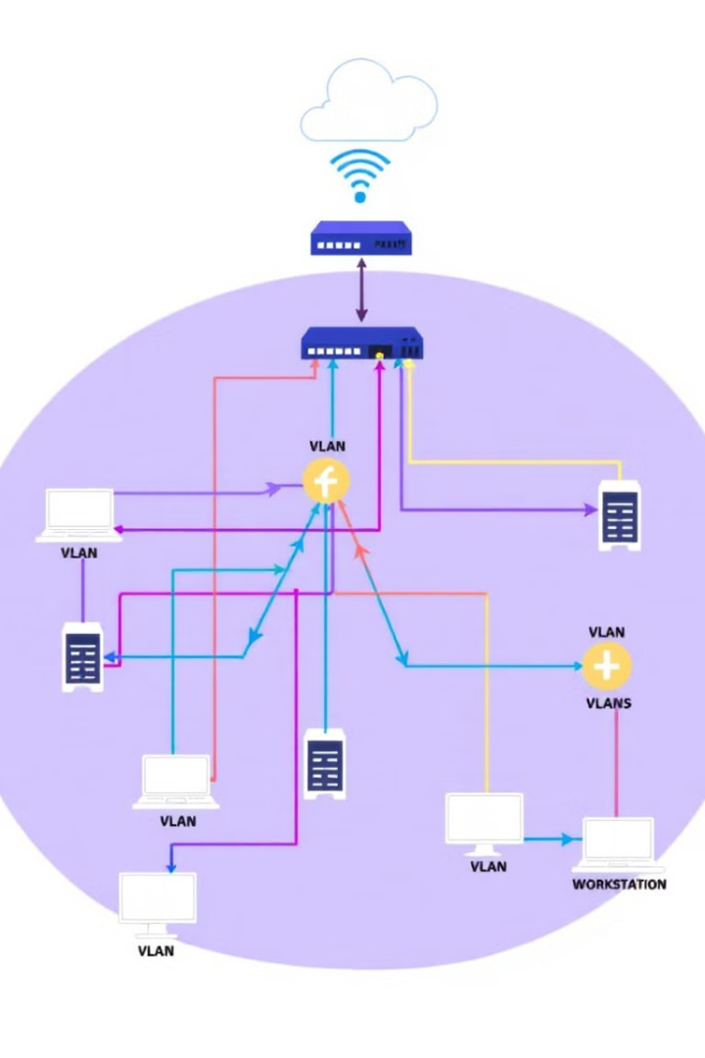




Network Connectivity
Router to Multilayer Switch
Connected via a trunk link to allow multiple VLANs.
Multilayer Switch to Access Switches
Each access switch connects to the multilayer switch for VLAN communication.
Servers Connection
Servers are connected to a switch, which in turn connects to a multilayer switch to ensure optimal performance.
Workstation Connection
Workstations are connected to the access switches, distributed across various VLANs.

Slide 9
Demilitarized Zone (DMZ) Implementation
Isolating Public-Facing Services
Secure Access Controls
Enhanced Security
Flexibility and Scalability
This setup safeguards sensitive internal resources while maintaining functionality for external users, effectively mitigating potential threats.
We implemented a dedicated VLAN for the DMZ, separating public-facing services from the internal network.
We configured Access Control Lists (ACLs) to strictly control traffic between the DMZ and the internal network, allowing only authorized access.
The DMZ approach provides a robust alternative to traditional firewalls, offering a flexible and scalable solution for network security.

Slide 10
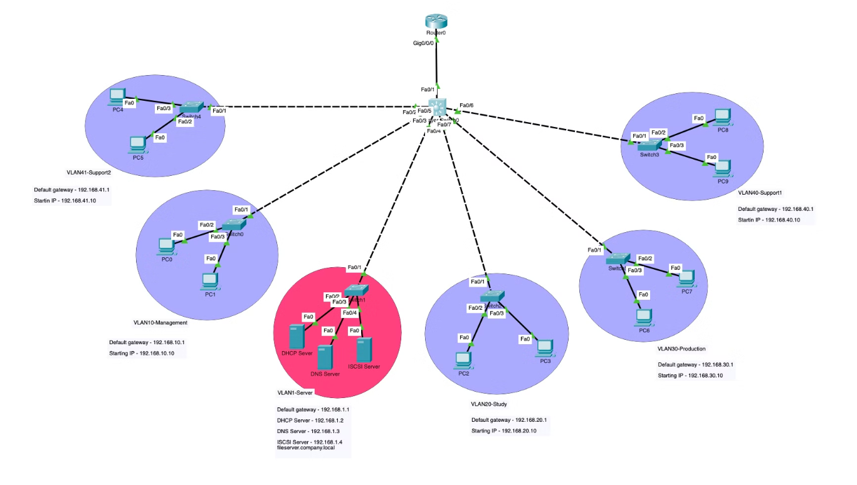
Network design

Slide 11

Conclusion and Future Considerations
1
Accomplishments
Successfully implemented a secure and efficient network infrastructure that meets current organizational needs.
2
Scalability
The network design allows for future expansion and addition of new VLANs or services as needed.
3
Performance Monitoring
Implement ongoing network performance monitoring to ensure optimal operation and identify potential bottlenecks.
4
Security Updates
Regularly review and update security measures to protect against evolving cyber threats.

Slide 12

Thank you for your attentions

